Slide 1
How can we make Husky ADAPT a sustainable program?
Joe Lawler, Alyssa Spomer, Keshia Peters, Katherine Steele

Slide 2
What is Husky ADAPT?
New student run organization at the University of Washington
ADAPT stands for Accessible Design and Play Technology
Expose groups of engineering students to accessibility projects

Slide 3
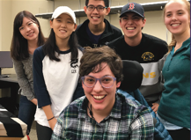
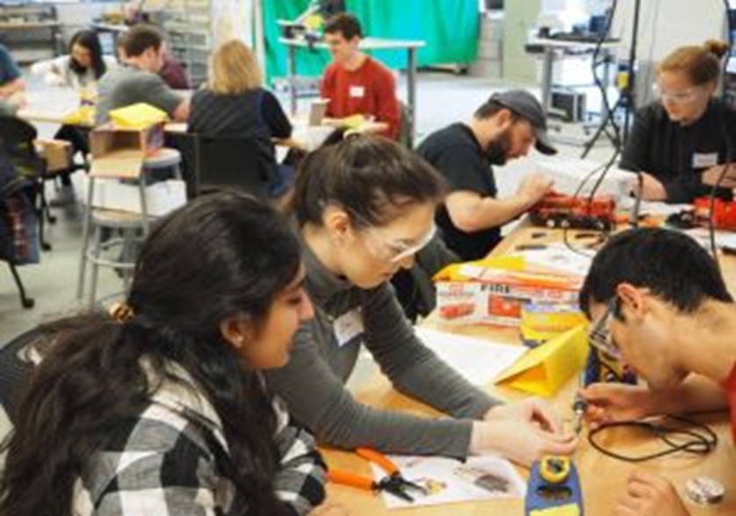
Husky ADAPT 2017-2018
Adapted 224 Toys
Taught 348 people Toy Adaptation
Launched an open source library of adaptable toys
Created 19 Design Teams developing accessibility solutions

Slide 4
Sustainable Program
Focused on preservation and transfer of information
Store all documentation from last years design projects in one central location
Allows others to explore, download and iterate upon our work
Replicate and build upon previous work
Create the design challenges for 2018-2019

Slide 5
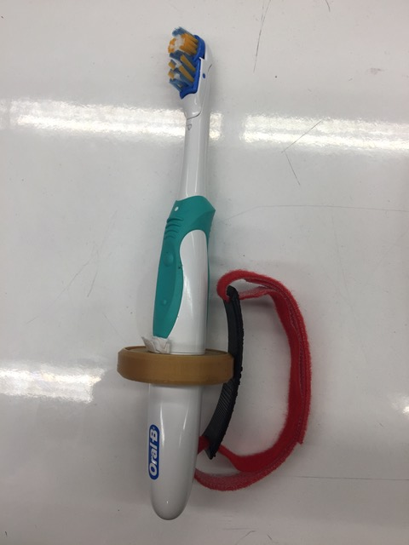
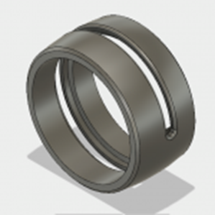
Furthering a Design Project
How can we help individuals with limited hand function perform daily hygienic tasks?
Built upon the work performed by Team Cajun
Created a modular tool that enables user to effectively manipulate a variety of objects
Rotates toothbrush to users needs
360 degrees laterally
270 degrees centrifugal

Slide 6
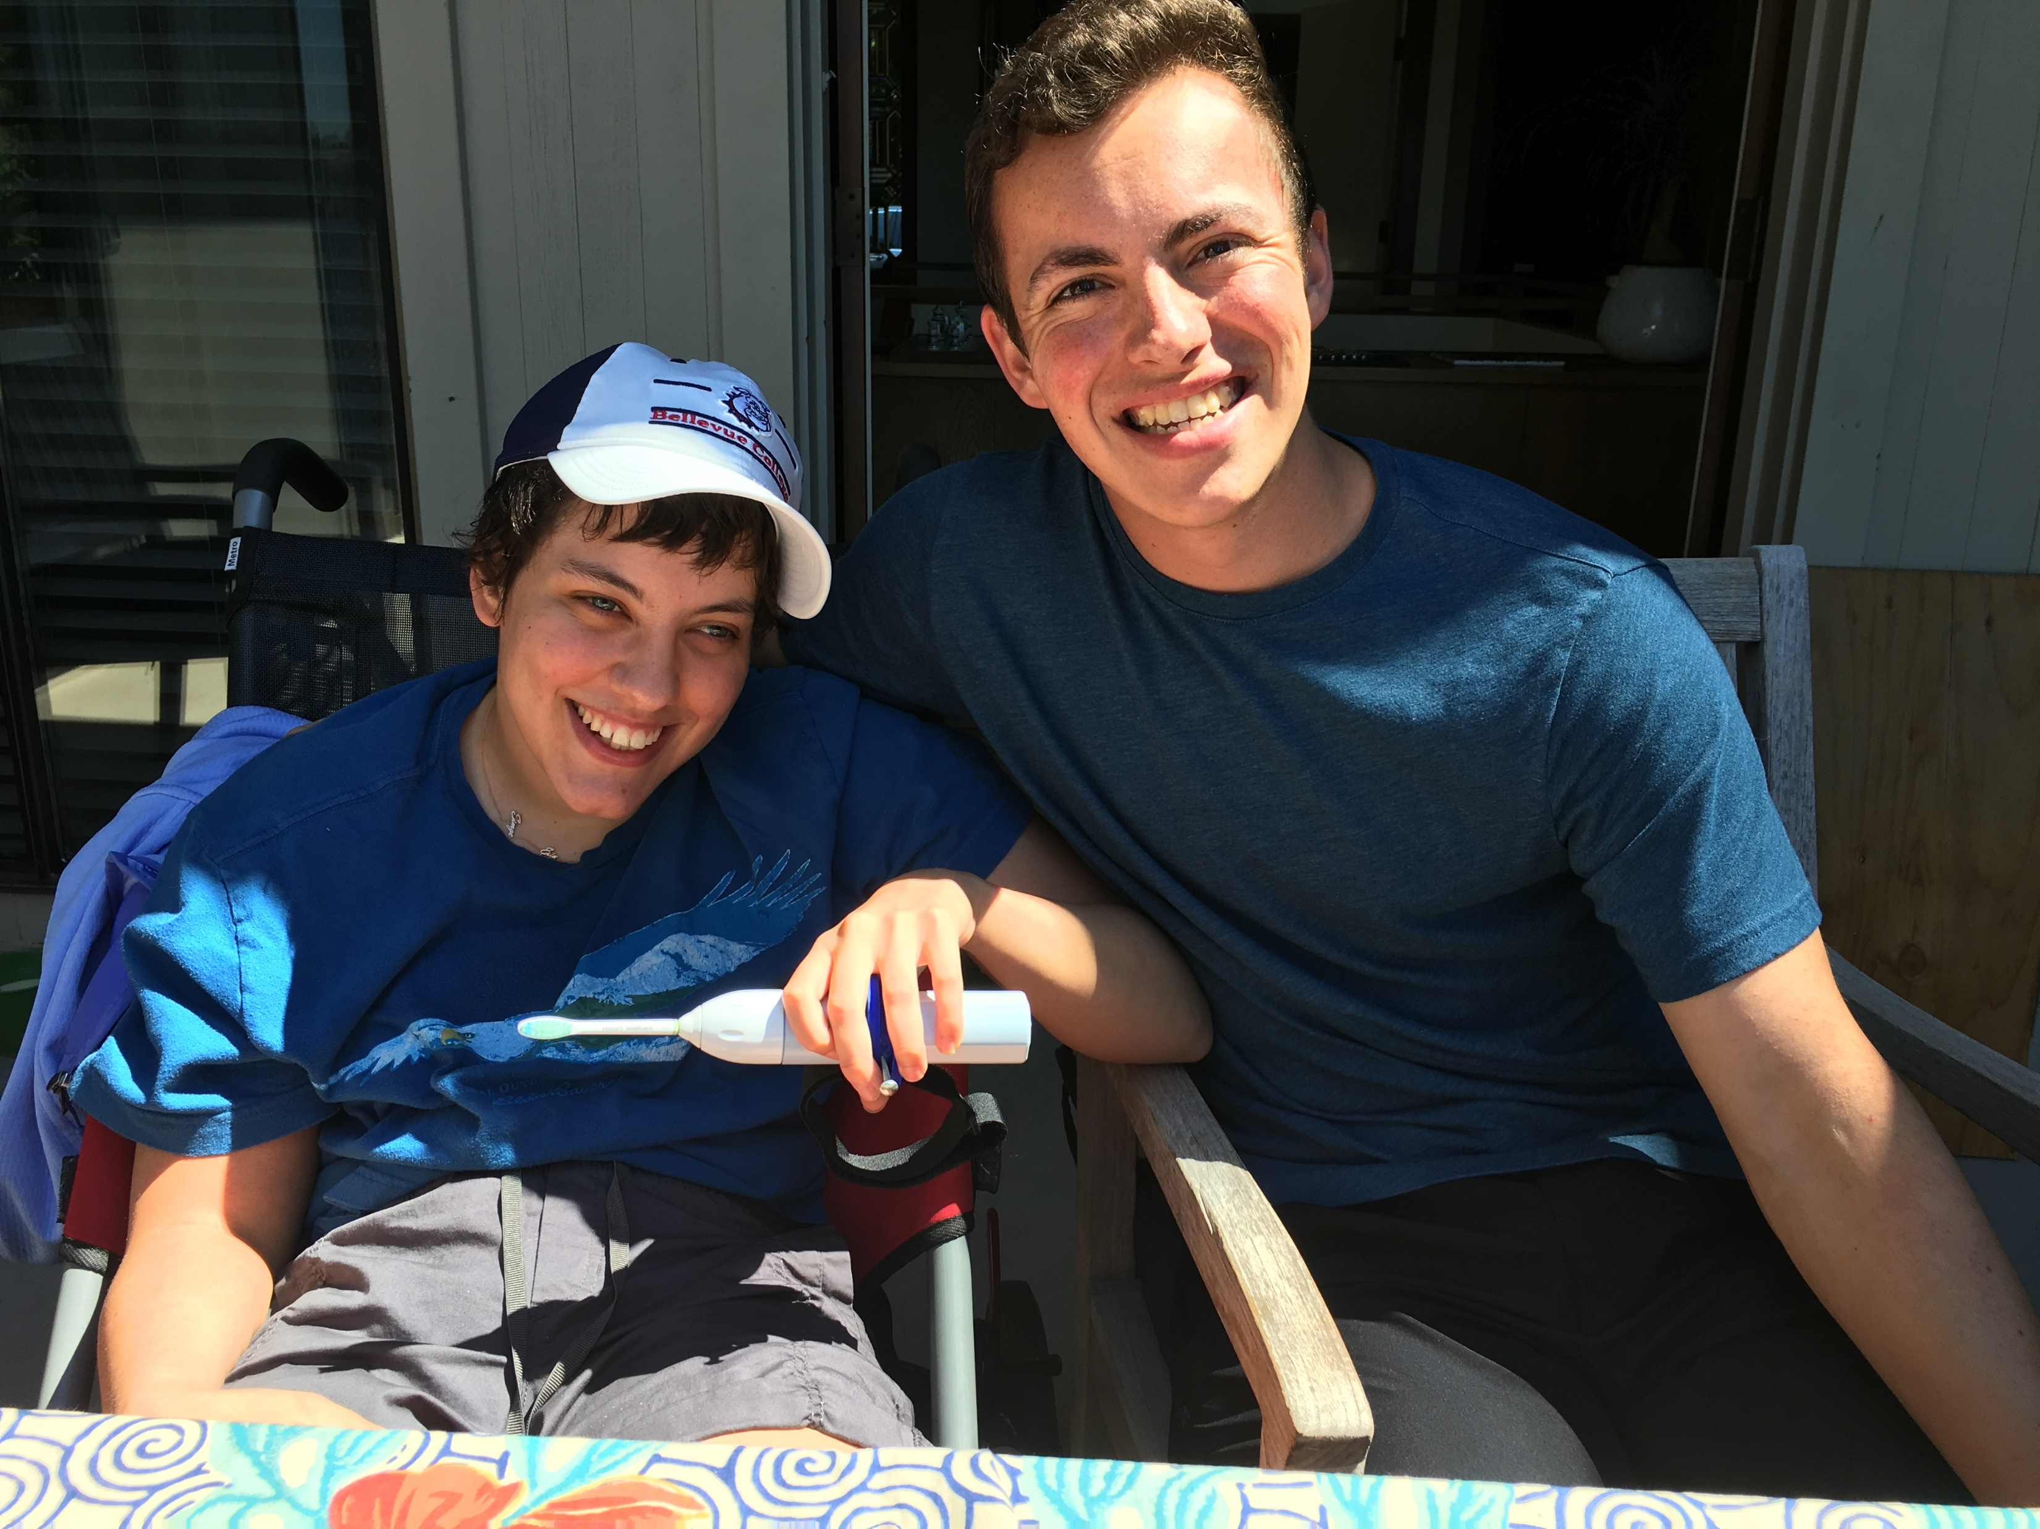
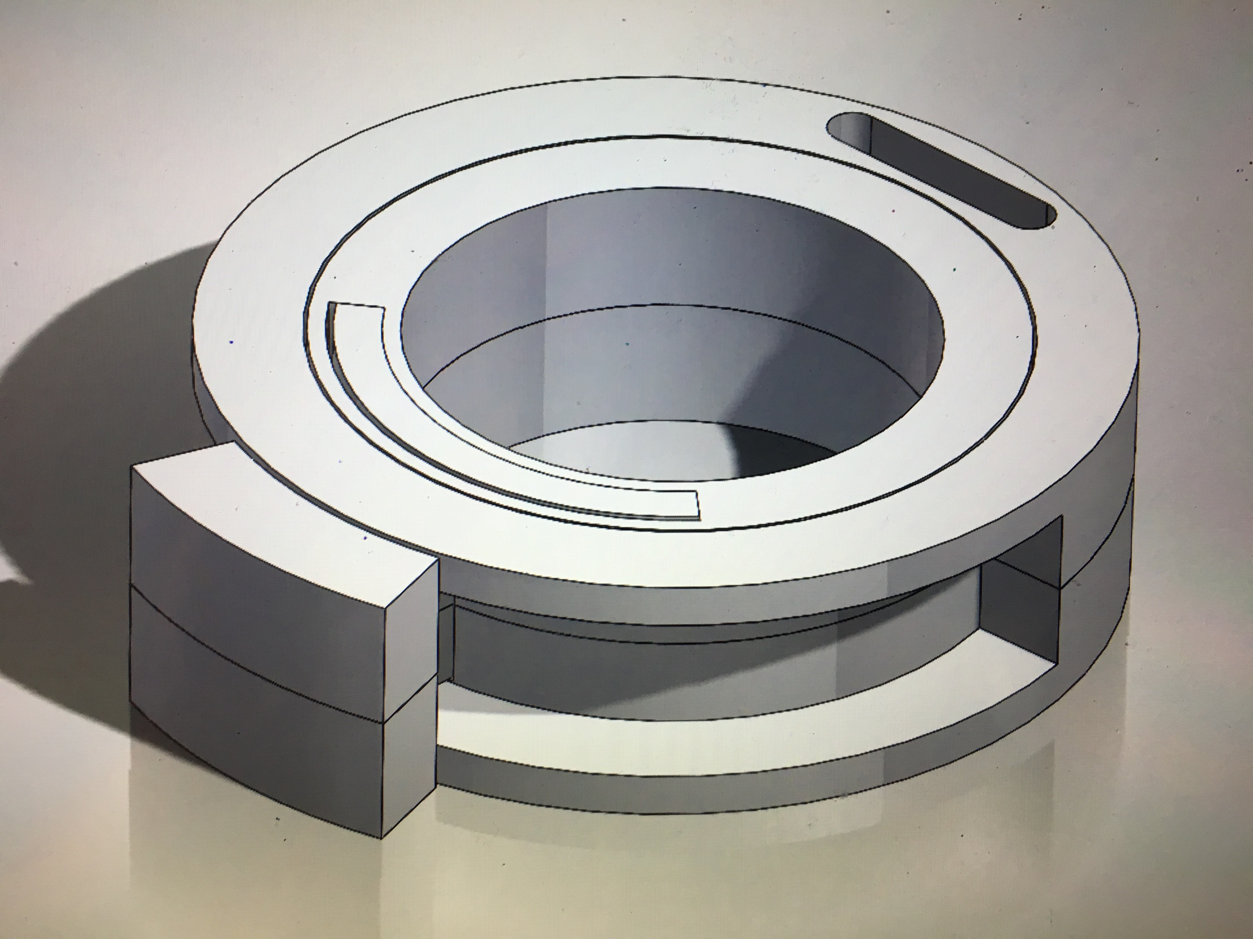
Furthering a Design Project
Designed a tool specifically for need expert Erin Ciliv
A need expert is a community member who provides invaluable insight on a particular disability
Iterated multiple prototypes based off of user feedback
Device builds upon Erin’s ability with her left hand
Rotates 180 degrees
Future
Implement attachment to act
as a button
Modify toothbrush stand

Slide 7
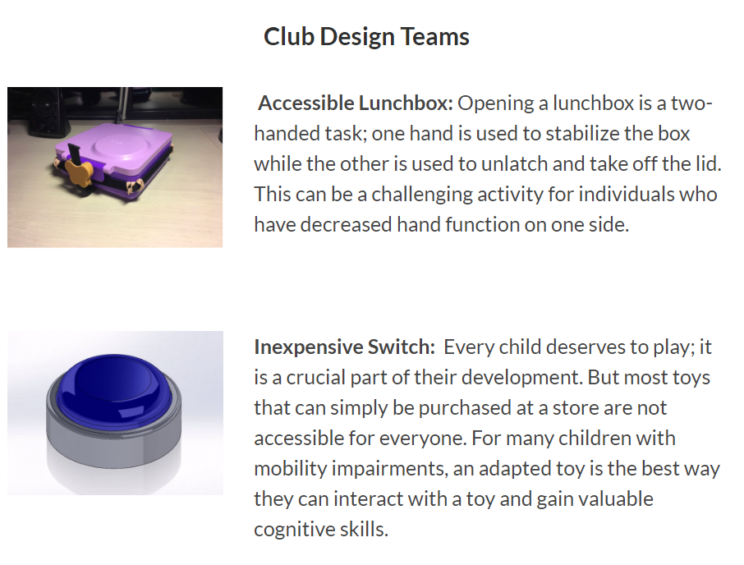



Design Projects 2017-2018
Created a website showcasing all past and ongoing projects
Ensures others may explore and iterate upon our work
Incorporated accessibility features
Alternative text, screen reader compatible

Slide 8
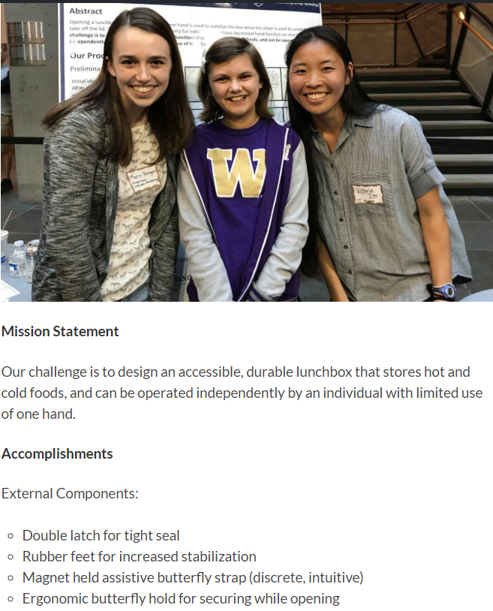
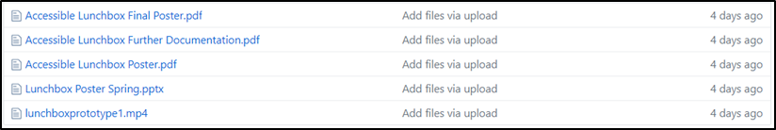
Design Projects 2017-2018
Each design team has their own page
Mission statement, accomplishments, next steps and files
Provides access to Github repository of documentation
Community can get a first hand look at the design process
Able to utilize our designs by downloading CAD files

Slide 9
Design Projects 2018-2019
Facilitate the creation of the design projects for next year
Systematic approach to be replicated in future years
Modified existing survey sent out to need experts
Sets expectations for need experts and teams
Incorporated feedback from experts in the field
Centralized repository of community members contact information
Created an interview document for meetings with need experts
Formatted to ensure most valuable information is gathered
Future
One page summary of each design challenge

Slide 10
Future of Husky ADAPT
Program is set up to continue its success
We hope that other universities adopt a similar model
Husky ADAPT will continue to expand our network of community members, increasing our impact

